Slide 1




Business Training
Learning Skills
The Vision

Slide 2
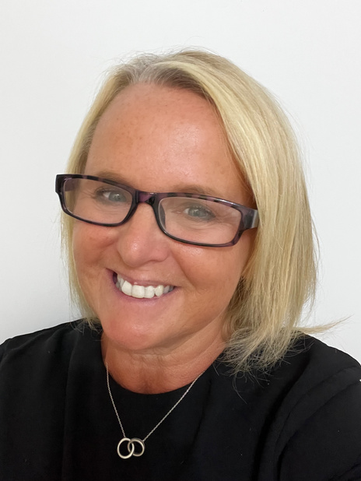
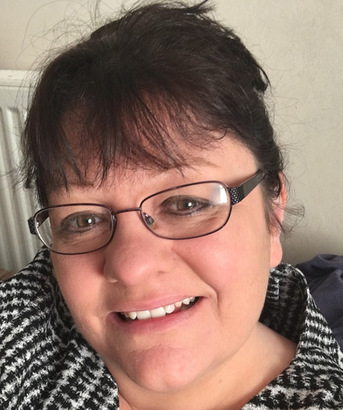
A NOTE FROM SARAH & JULIE
WELCOME
Dear Hair and Beauty colleague,
As experienced Hair and Beauty salon owners we believe the reason most Hair and Beauty businesses fail is they do not have sufficient knowledge on how to build an successful salon or hair and beauty business from the start.
Julie and Sarah have both built, run and sold salon businesses and were able to retire from the salon floor. We are now sharing this knowledge, not only with their salons that use the government funded apprenticeships, but also with people who are looking to get into business for the first time by teaching them the six main areas that you will need to have knowledge in and be able to measure as you build a successful salon or hair and beauty business.
This course will help you to learn the fundamentals for any hair and beauty business owner in 10 weeks.
Wishing you every success in your business, we are here to help and guide you on that journey.
Sarah Abel & Julie Donoghue.
Sarah & Julie
TNB TRAINNG
Directors

Slide 3
TOPIC ONE
VISION
So Freya and Lucy have both finished their TNB training business mentoring programme and are getting excited about starting
their own training businesses.
Where to start?
LAID BACK LUCY
Lucy has spoken to a friend of a friend and she been offered a chance to teach in someones salon & she has accepted even though she has never visited the salon or even knows where it is. She is yet to find out how much it will cost and what the premises looks like & how many days she can deliver the training in the salon. Lucy doesn’t really know what she wants to do but at least it is a start.
FOCUSSED FREYA
Freya has a different approach she has spent time defining where she wants to be in 3 years. She has created a vision board showing a picture of her dream car a “Red Audi Cabriolet”, she has glued onto the poster an image of her smart branded training academy as well as the people she aspires to be like, She has written her goals and documented a plan and the steps she needs to take to move towards her vision. She knows exactly what she needs to do next and is ticking off her goals on her plan as she takes each step.
ARE YOU A FREYA OR A LUCY ?
Vision
WORKBOOK
© 2022 Sarah Abel

Slide 4

TOPIC ONE
VISION
What is a Vision?
A vision is a mental picture produced by your imagination, a view
of your future. This can be applied to any part of your life whether
it is your personal life, your relationships or your professional life.
In this instance we are looking at creating a “Vision” for your Hair & Beauty Business.
A vision considers the intent of your business; it sets a course and a direction. It allows you to focus your attention on your strategy to achieve this vision. This vision should excite you and motivate
you to take action.
It’s a “Sat Nav” for your life, you identify where you are, where you want to go and then you can start the journey towards this new future.
By having a “vision” documented you have something to go back to, to reflect, to adjust and to re-focus your attention as to what you wish to achieve.
TNB DIRECTOR JULIE'S
VISION BOARD
Vision
WORKBOOK
The Dream
WORKBOOK
© 2022 Sarah Abel
© 2020 ANNABELLE WEBSTER

Slide 5


TOPIC ONE
VISION
WORKSHEET 1
WHY START A TRAINING BUSINESS?
INSTRUCTIONS:
Why do you want to build a training business ?
To the mind-map below add YOUR reasons for wanting to train others in the hair and beauty industry.
Example......
It is something I have dreamed of since being little.
Why do I want to start a training business ?
Vision
WORKBOOK
© 2022 Sarah Abel

Slide 6
TOPIC ONE
VISION
Your WHAT, Your WHY, Your HOW
Visions should identify your “What”, your intent – What you wish
to achieve (to own a brand new car, or retire from the chair or salon)
and most importantly the “Why” this is your purpose for setting
the vision (to give me financial freedom, to provide flexibility around child care).
The “Why” is very important as it motivates you to achieve and push yourself; this is different for everyone and could be success,
recognition, flexibility or financial freedom.
Finally, the “How”, this is the planning section (covered later), the HOW you are going to achieve your vision – what actions you need to take to move you forward.
How a vision helps you make decisions – Example:
You are a mobile coach assessor and teacher
Your vision is to build a business that gives you flexibility around your family.
A college offers you a position, guaranteed wages, full time, one day off in the week and working every Saturday.
What do you say?
By having a “vision” documented you have something to go back to, to reflect, to adjust and to re-focus your attention as to what you wish to achieve.
Vision
WORKBOOK
© 2022 Sarah Abel

Slide 7

TOPIC ONE
VISION
First think about how you would like to document your vision, either by creation of a “Vision Board” - the cutting and sticking of images and quotes onto a poster,
or
Writing a “Story” or “Vision Description” by way of a documented account that could be a “day in the life of” or any written document that feels right!
The visioning exercise is about visualising yourself at a time in the future where your business is exactly as you want it to be. It may be you don’t know exactly what that is yet! Don’t worry, just use your imagination for the minute and see what you come up with.
Think about how you would like your life to look in ONE YEARS TIME, TWO YEARS TIME, or THREE YEARS TIME!
Remember - This is not cast in stone – there is no wrong –
there is only YOU – and it can be adapted, changed, tweaked!
Vision
WORKBOOK
© 2022 Sarah Abel

Slide 8
SARAH VISION
Sarah's “Vision”
I am sitting in my cabin in my garden in March 2026 with my morning coffee looking back at my house that Andy and I have converted into our dream home with its open planned downstairs. It has a gym, a walk-in wardrobe, state of the art kitchen with all the gadgets! All our bedrooms have Vellux windows where the sunlight streams in every morning making me feel glad that I am alive and I am grateful for every new day. What's more I only work when I want to and I have multiple successful businesses with a net worth of £5,000,000. I have teams that run all my businesses on a day to day basis and I have coached 100's of hair and beauty professionals to make more money than they have ever dreamed of.
I am personally generating a reoccurring passive income of £20,000 a month as a minimum and I have created a legacy that can be handed down to my kids and their kids.
I regularly speak on stages all over the world inspiring 1000's of people to pursue their dreams and have won many business awards for the work that I do and I only now have to do what love.
Andy and I regularly travel in our motor-home all over Europe and the UK and I work from the places we travel to if I choose to. I have a minimum 13 weeks holiday scheduled a year and I often take family and friends with me. I only stay in 5 star accommodation and travel first class to all of the countries on my bucket list and have just booked our 3 month luxury world cruise that I cannot wait to go on.
I am the fittest and slimmest I have ever been with so much energy. I spend lots of time with my children and grandchildren teaching them what is important and encouraging them to live their best life. I have a network of family and friends that love me for who am I and enjoy spending time doing the things we all love to do.
Vision
WORKBOOK
© 2022 Sarah Abel

Slide 9
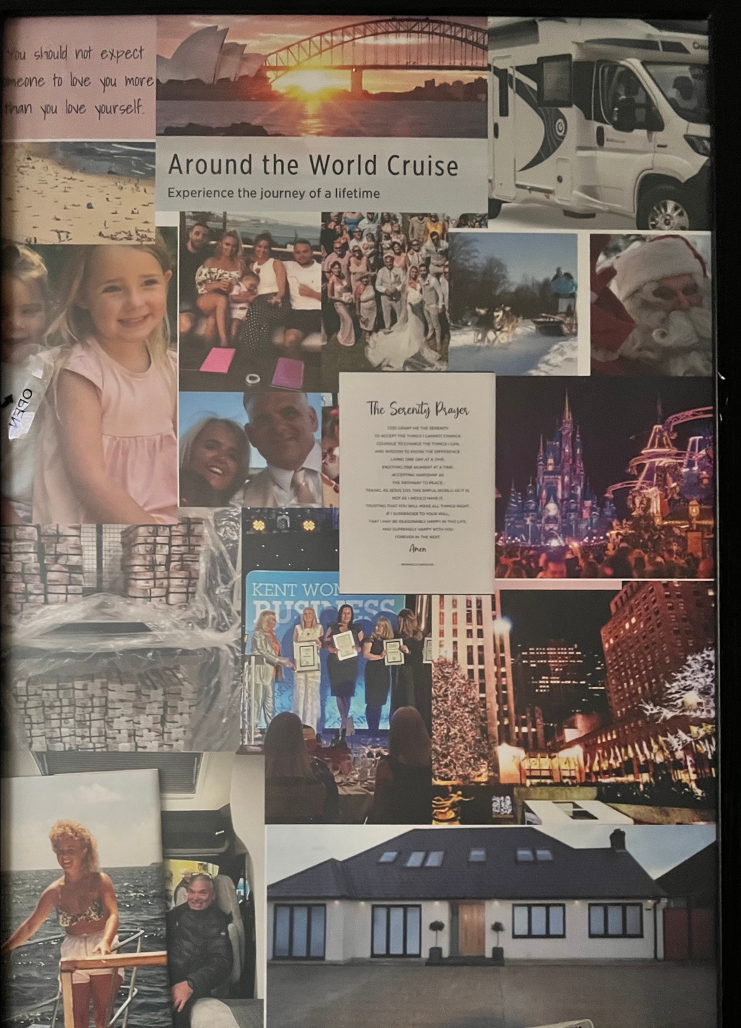
SARAH VISION BOARD
Vision
WORKBOOK
© 2022 Sarah Abel

Slide 10

TOPIC ONE
VISION
What happens if you do not establish a Vision?
Vision gives direction and a glimpse over our life to make our goals and purpose become a reality. In order to understand where we want ourselves to be in life, we must have a clear vision over our life. So, once you understand that vision clarifies purpose, life will become simpler and more meaningful.
You and your team lose sight of why you are doing this; you and they get their heads down and get busy and work work work! However, you do not move forward to your vision.
By ploughing on day after day you can then begin to hate owning a business or question why you're doing it. Taking time to work ON your business allows you to work on achieving your goals and your teams and without it you can be attracted by outside influences and be diverted from your and your teams goals.
DO IT NOW! Book yourself time in your diary to create your vision.
If you need inspiration why not view Julie and Sarah’s visions to help you get started.
TIP: You can always do this in stages, Attempt the process then
a week later reflect and make changes that feel right before you finally decide you are there !
Vision
WORKBOOK
© 2022 Sarah Abel

Slide 11
TOPIC ONE
VISION
TOPS TIPS for getting your Vision onto paper
1. WRITE IT DOWN
With a pen or pencil (if you are like us you will have lots of coloured pens!), By re-reading your own handwriting it fixes an impression into your memory better than reading from a screen.
2. BE HONEST
Don’t write what you think you SHOULD write, be honest about what YOU want. You can think BIG BIG BIG or go for what you feel is right. (It cannot be wrong!)
3. WRITE IN THE PRESENT
“I HAVE a successful salon in the centre of town with 3 staff and a growing clientele”.
4. KEEP IT POSITIVE
Focus on the POSITIVE what you WANT “I have £3000 in savings” rather than I DO NOT have debt.
5. KEEP IT REAL
These are YOUR PERSONAL goals – write them how you would say them. No fancy words. Just write as you would vocalise them.
6. IT'S ALL IN THE DETAILS
DETAILS - it’s all in the detail! If you know what colour your new car is going to be or the model, then put it in! Describe the smell, the atmosphere, your surroundings, the colour, your feelings of your vision.
6. REVISIT & REVIEW
It is OK to CHANGE your vision! As you go through life your priorities change – having a family, moving home, changing partners, they may affect your vision. That is fine – if it doesn’t feel like a great fit then just re-work it and you have a new direction.
Vision
WORKBOOK
© 2022 Sarah Abel

Slide 12
TOPIC ONE
VISION
WORKSHEET 2
VISION QUESTIONS
What should you consider to be included within your Vision ?
This is your “WHAT” - the details
QUESTION : If you won the lottery tomorrow what would you do first?
QUESTION : What type of things do you love to do on a day to day basis if you took money out of your decision making?
QUESTION : Who is in your team? Include your “support” network – people you aspire to be like that may agree to mentor you.
QUESTION : Who do you wish to professionally collaborate with?
Vision
WORKBOOK
© 2022 Sarah Abel

Slide 13
TOPIC ONE
VISION
WORKSHEET 2
VISION QUESTIONS
QUESTION : What sort of personal income do you want, i.e. what is your money pot?
QUESTION : What does “success” look like?
QUESTION : What kind of person are you? How would people describe you?
QUESTION : Where are you living? What hours are you working?
Vision
WORKBOOK
© 2022 Sarah Abel

Slide 14
TOPIC ONE
VISION
WORKSHEET 2
VISION QUESTIONS
QUESTION : Who do you love serving?
QUESTION : Does your business run smoothly without you?
QUESTION : What are you doing regularly to work ON your business?
QUESTION : What is your role in the business ?
Vision
WORKBOOK
© 2022 Sarah Abel

Slide 15
TOPIC ONE
VISION
WORKSHEET 2
VISION QUESTIONS
QUESTION : How will this impact your family and friends when you achieve it?
Now read through all of the above and describe below WHAT your “Vision” is for your training business
Vision
WORKBOOK
© 2022 Sarah Abel

Slide 16
TOPIC ONE
VISION
WORKSHEET 2
QUESTION : Why is having vision important to the success of a business?
Now read through all of the above and describe below WHY you want to achieve your “Vision” for your training business
Vision
WORKBOOK
© 2022 Sarah Abel

Slide 17



VISION BOARD WORK SHEET 3
WEALTH GOAL
HEALTH GOAL
LOVE
FAMILY
CAREER
SPIRITUALITY
KNOWLEDGE
NOTES

Slide 18
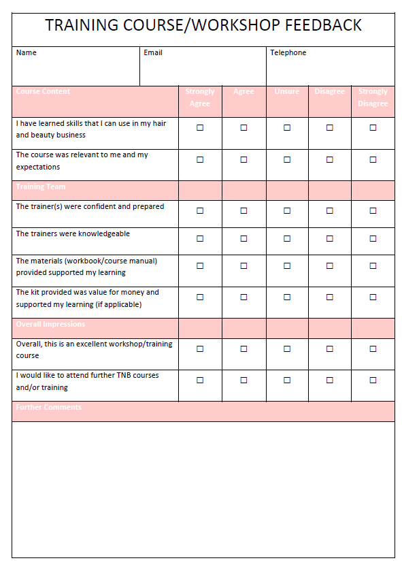
VISION WORKSHOP FEEDBACK
Vision
WORKBOOK
© 2022 Sarah Abel

Slide 19
Notes
Vision
WORKBOOK
© 2022 Sarah Abel

Slide 20
Notes
Vision
WORKBOOK
© 2022 Sarah Abel

Slide 21

THE FUTURE BELONGS TO THOSE WHO BELIEVE IN THE BEAUTY OF THEIR DREAMS.
ELEANOR ROOSEVELT

