Slide 1
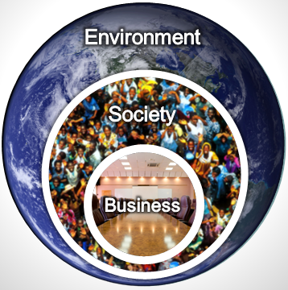

21st CENTURY BUSINESS MODEL TEMPLATE
Notes:
(

Slide 2
21st Century Business Model
Design Points
Acknowledge nested interdependencies: Show that business is nested in society ‒ and optionally the economy ‒ which is nested in the finite environment on a finite planet. Use this system view to show touch points where the business impacts its nests, and vice versa, in the 21st century.
Show flows: Show the overall input‒process‒output flow between the business and its nests and stakeholders.
Include traditional business elements: Include traditional business model components that enable the business to create value for its stakeholders.
Connect the dots: Show how reputation, savings, etc. from the business’s impacts on the environment and society contribute to business financials, to portray the business case for sustainability initiatives.
Include a circular economy: Show how the business model supports a circular economy.
Include new risks: Show how new global environmental, social, and technological risks can threaten businesses and deserve inclusion in Enterprise Risk Management (ERM) processes and long-term strategic planning in the 21st century.

Slide 3


21st Century Business Model
ENVIRONMENT
21st century environmental risks
SOCIETY
21st century exponentially disruptive technologies
21st century social risks & expectations
ECONOMY
THE BUSINESS
Social licence & other income
SOCIAL & RELATIONSHIP CAPITAL
Impacts on
SOCIAL & RELATIONSHIP CAPITAL
Community
Other
stakeholders
(relationships
& needs)
Governance
Purpose / Vision / Mission / Policies / Strategies …
Reputation
& savings
Reputation & revenue
HUMAN
CAPITAL
HUMAN CAPITAL
Products & Services
(value they create to satisfy stakeholder needs)
Channels
Customers
(relationships
& needs)
Suppliers
Activities & Processes
Products’ impacts on
NATURAL CAPITAL
Impacts on NATURAL CAPITAL
Materials, water & energy
Reputation
& savings
Reputation & savings
Operational impacts on NATURAL CAPITAL
FINANCIAL,
INTELLECTUAL & MANUFACTURED CAPITALS
FINANCIAL CAPITAL
Profit
Market value
Brand value
INTELLECTUAL CAPITAL
Patents
Copyrights
Licenses
MANUFACTURED CAPITAL
Buildings Furnishings
Equipment
Infrastructure
Reputation & savings
Circular economy

Slide 4






Example –
Sustainability Advantage Business Model
ENVIRONMENT
21st century environmental risks
SOCIETY
21st century exponentially disruptive technologies
21st century social risks & expectations
ECONOMY
Sustainability Advantage
Social licence & other income
Impacts of taxes & donations on
SOCIAL & RELATIONSHIP CAPITAL
SOCIAL & RELATIONSHIP CAPITAL
Community
Other
stakeholders
Mission: Provide resources to sustainability champions to accelerate our sustainability journey, before it’s too late.
Reputation
& savings
HUMAN CAPITAL
Contractors
Bob
Reputation & revenue
HUMAN
CAPITAL
Products & Services
Talks
Books
Tools
Help
Channels
Events, web, stores, publisher, others
Sustainability
Champions
Biz Leaders
Suppliers
Activities & Processes
Research & development
Writing
Communications
Products’ impacts on
NATURAL CAPITAL
Activities & Processes
Impacts on NATURAL CAPITAL
Utilities,
books,
supplies
Reputation
& savings
Reputation & savings
Operational impacts of home office on
NATURAL CAPITAL
FINANCIAL,
INTELLECTUAL & MANUFACTURED CAPITALS
FINANCIAL CAPITAL
Profit
Cash flow
Brand value
INTELLECTUAL CAPITAL
Creative Commons licensing of all resources
MANUFACTURED CAPITAL
Computer system
Office furniture
Library
Infrastructure
Reputation & savings
Circular economy

Slide 5
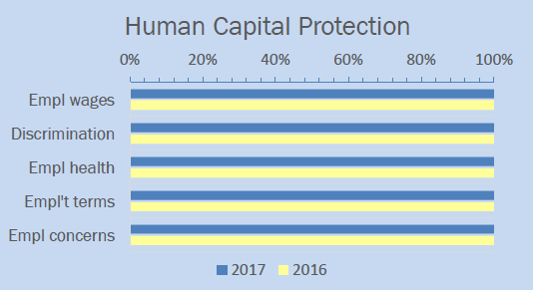
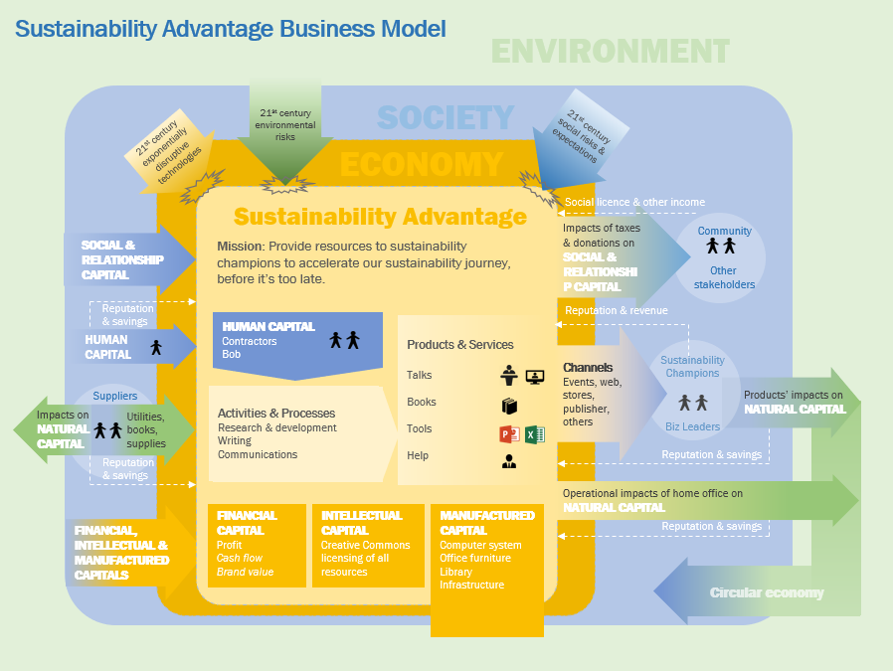
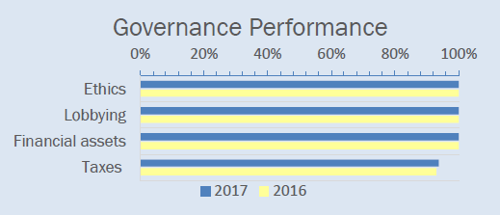
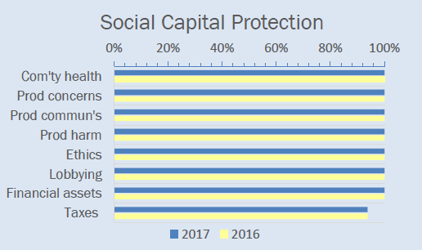
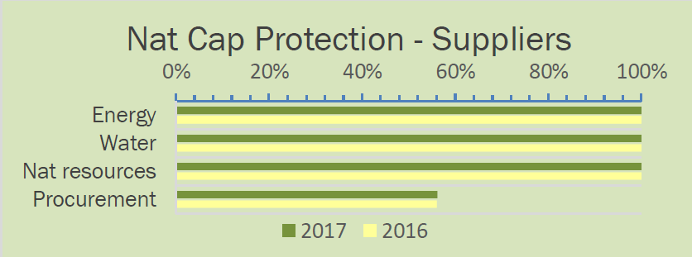
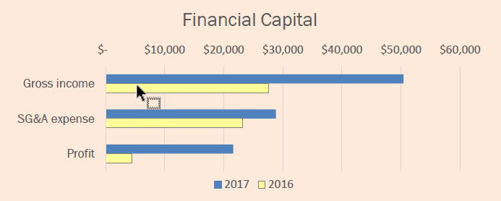

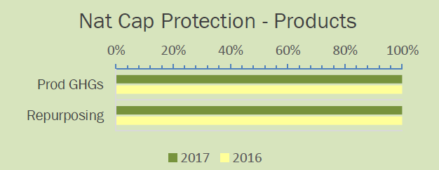
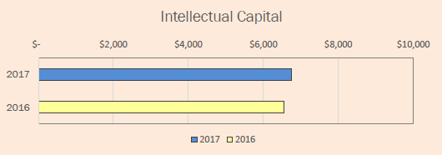
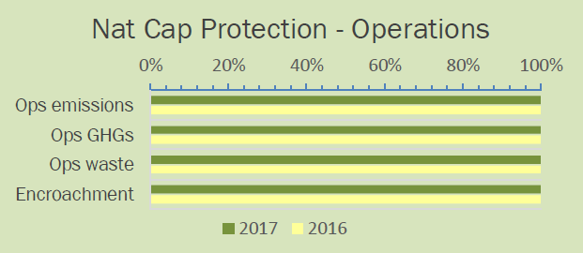
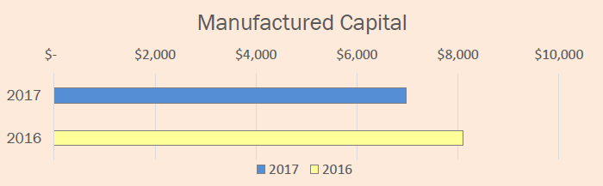
Example of business model used as <IR> infographic –
Sustainability Advantage <IR> inforgraphic
100%
98%
89%
99%
100%
100%
Note: Percentage scores indicate success protecting the value of the indicated capital, assessed using relevant Future-Fit Business Benchmark cause-no-harm goals.
Infographic from Integrated Report 2017 for Sustainability Advantage sole proprietorship

Slide 6
The 21st Century Business Model
is based on the following
business model frameworks

Slide 7
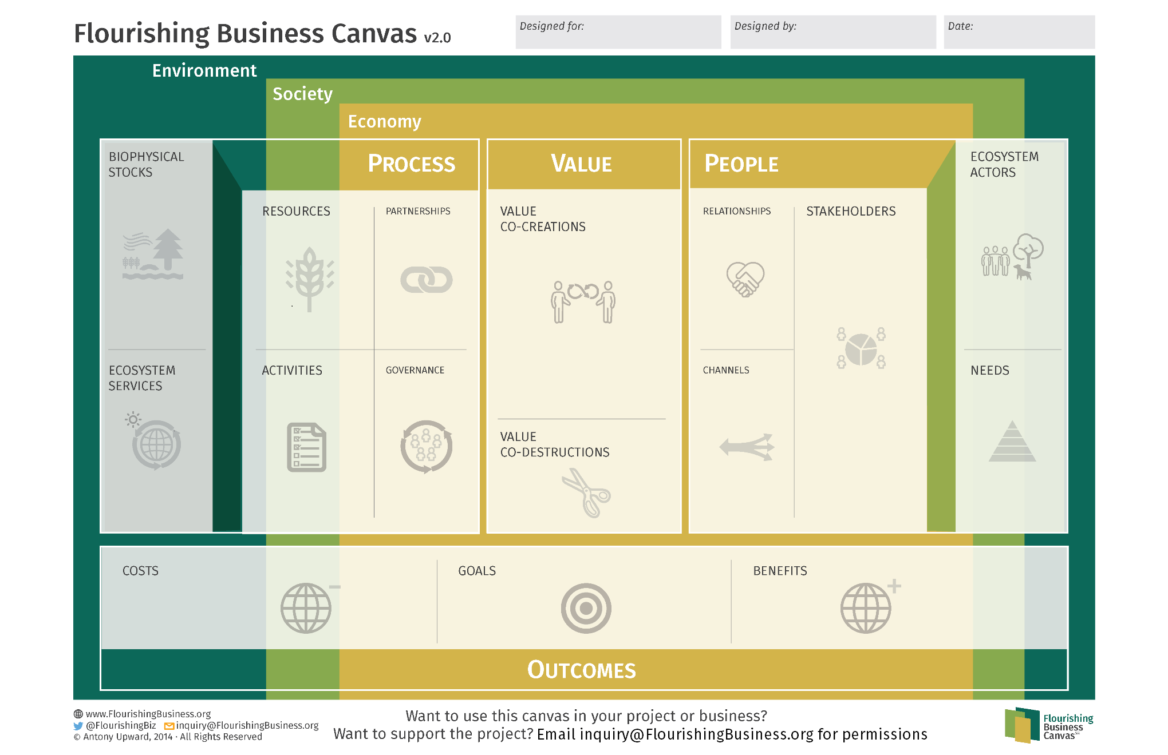
https://drive.google.com/drive/folders/0B30i3w7ZW4ZMcnk0UEtncG5HaW8?usp=sharing

Slide 9
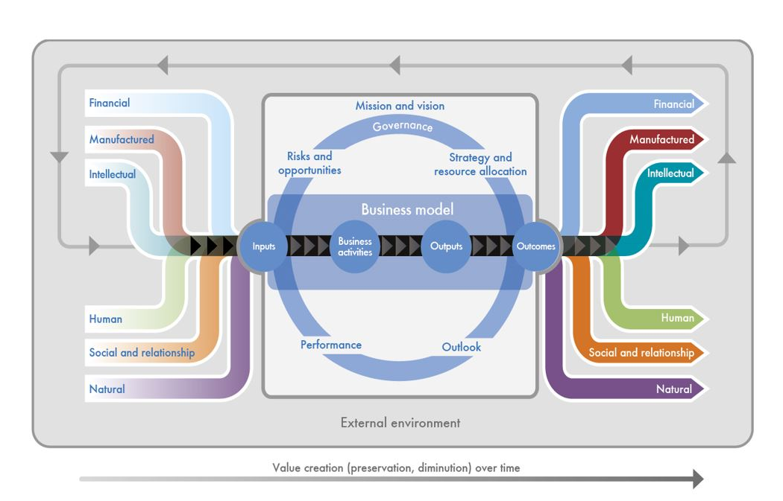
<IR> “Octopus” Business Model
http://integratedreporting.org/what-the-tool-for-better-reporting/get-to-grips-with-the-six-capitals/

Slide 10
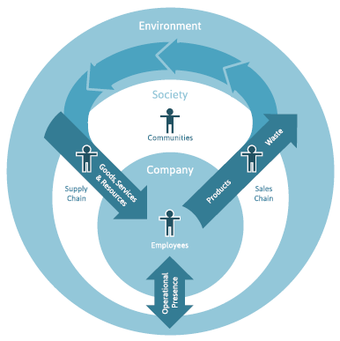
Future-Fit Business Benchmark - Core Business Model Graphic
http://futurefitbusiness.org/wp-content/uploads/2017/11/F2B2-Methodology-Guide-R2.0.4.pdf

Slide 11
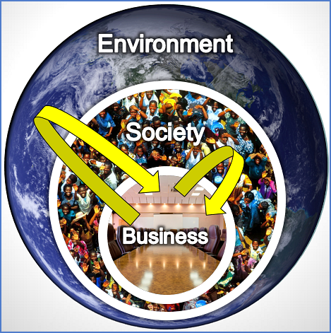
Nested Interdependencies Model

Slide 12
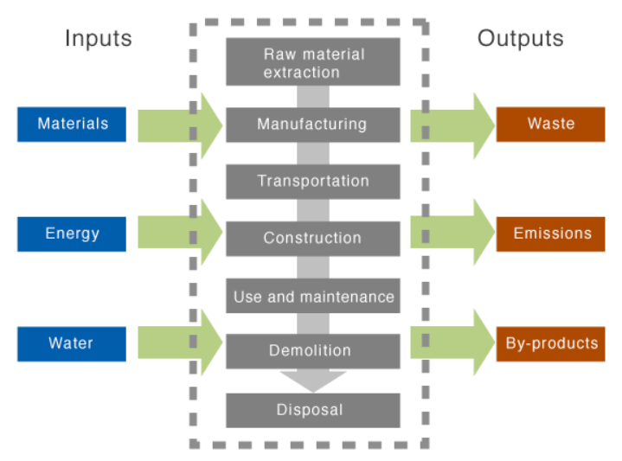
Life Cycle Business Model
http://www.greenspec.co.uk/life-cycle-assessment-lca/

Slide 13
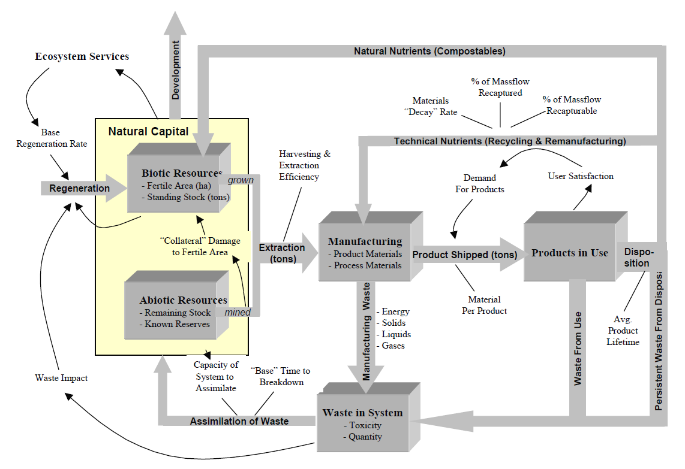
Industrial System Stock & Flow Framework
Senge, P. M., Seville, D., Lovins, A. B., & Lotspeich, C. (1999-Unpublished).
Chapter 1: The Four Basic Shifts. In Systems Thinking Primer for Natural Capitalism (pp. 1–11)..
http://www.donellameadows.org/archives/systems-thinking-primer-for-natural-capitalism-the-four-basic-shifts/

Slide 14
Backup for the new 21st century
Technological, Environmental and Social Risks
shown at the top of the business model

Slide 15
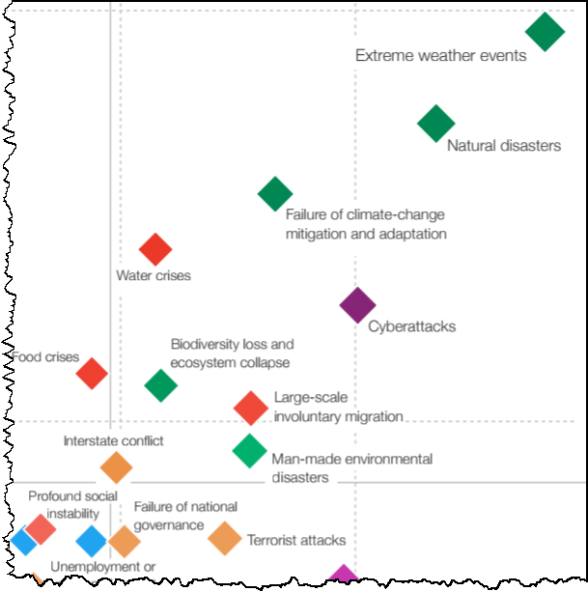
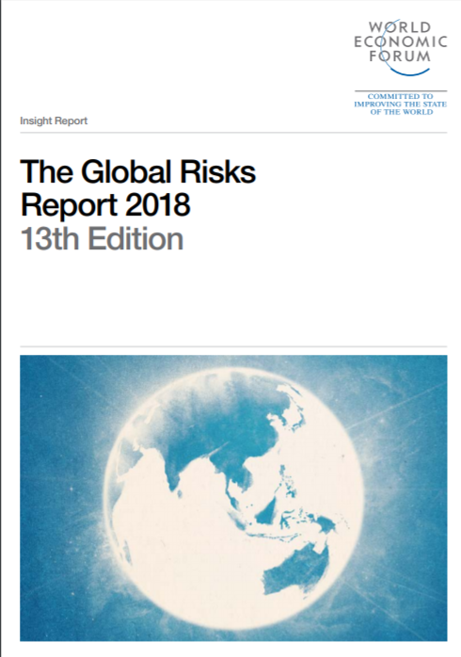
High
Impact
Likelihood
High
“Global Risks 2018,” World Economic Forum (WEF), January 2018.

Slide 16
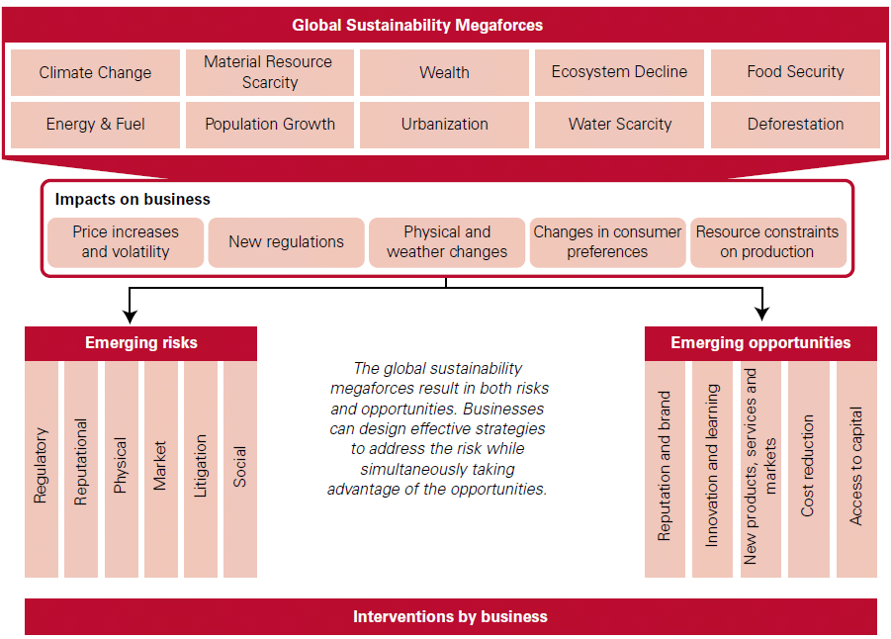
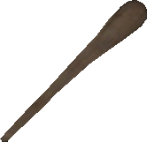

“Expect the Unexpected: Building business value in a changing world,” KPMG, 2012.

