Slide 1
STRATEGIC TEMPLATE
Business
Create,
Deliver
& Capture Value
Model

Slide 2
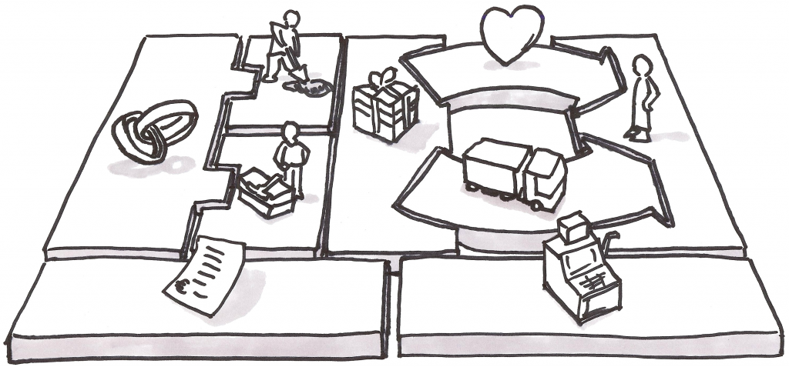
STRATEGIC TEMPLATE

Slide 3
The Business Model Canvas
KEY ACTIVITIES
KEY PARTNERS
VALUE PROPOSITION
CUSTOMER RELATIONSHIP
CUSTOMER SEGMENTS
KEY RESOURCES
CHANNELS
COST STRUCTURE
REVENUE STREAM

Slide 4
The Business Model Canvas
Key Activities
Key Partners
Value Proposition
Customer Relationships
Customer Segments
Key Resources
Channels
Cost Structure
Revenue Stream

Slide 5
The Business Model Canvas
Key Activities
Key Partners
Value Proposition
Customer Relationships
Customer Segments
Key Resources
Channels
Cost Structure
Revenue Stream

Slide 6
The Business Model Canvas
Key Activities
Key Partners
Value Proposition
Customer Relationships
Customer Segments
Key Resources
Channels
Cost Structure
Revenue Stream

Slide 7
The Business Model Canvas
Key Activities
Key Partners
Value Proposition
Customer Relationships
Customer Segments
Key Resources
Channels
Cost Structure
Revenue Stream

Slide 8
The Business Model Canvas
Key Activities
Key Partners
Value Proposition
Customer Relationships
Customer Segments
Key Resources
Channels
Cost Structure
Revenue Stream

Slide 9
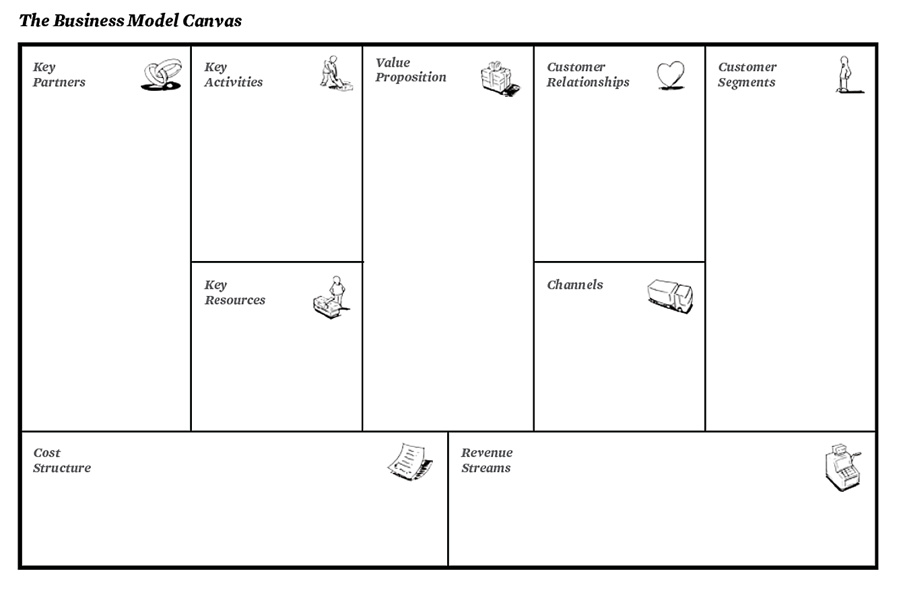

Slide 10
A business model describes how your organization creates, deliver and capture value.
It can be described through 9 blocks, covering 4 business areas
(Customers, Offer, Infrastructure, Financial viability).
1. CUSTOMERS
2. OFFER
3. INFRASTRUCTURE
4. FINANCIAL VIABILITY
- Your customer segments
- Your customer relationship model: how you find, acquire and build relationship with them
- Your activities
- Your value proposition: the products / services you offer that create value for your customer and why they’re unique
- Your partners - Your key resources: physical, intellectual, human and financial
- The channels: how you reach customers
- Revenue stream: how you make money
- Cost structure: all the costs incurred in your business operation

Slide 11
The Business Model Canvas
KEY ACTIVITIES
KEY PARTNERS
VALUE PROPOSITION
CUSTOMER RELATIONSHIP
CUSTOMER SEGMENTS
KEY RESOURCES
CHANNELS
EFFICIENCY
VALUE
COST STRUCTURE
REVENUE STREAM
REFERENCE: http://www.businessmodelgeneration.com/canvas/bmc

Slide 12
The Business Model Canvas
1. CUSTOMER SEGMENTS
The different groups of people your company aims to reach and serve:
a) Mass market: one large group with similar needs / problems (e.g. hypermarkets) b) Niche: specific / specialized customer segments (e.g. Porsche)
c) Segmented: slightly different needs / problems (e.g. medical)
d) Diversified: very different needs / problems (e.g. Amazon)
e) Multi-side platform: interdependent customers (e.g. Visa)

Slide 13
The Business Model Canvas
2. VALUE PROPOSITION
The product / services that create value for your customer segments + the reasons why these customers would turn to your company over another. The key elements of your value proposition are:
a) Newness: Satisfying a new set of needs (e.g. technology)
b) Performance: Improving performance (e.g. smartphones)
c) Customization: Tailoring to specific needs (e.g. suit’s rental)
d) Design / Brand status: Value in using a brand (e.g. fashion)
e) Convenience / Accessibility: Making products accessible (iPod)

Slide 14
The Business Model Canvas
3. CHANNELS
How you reach your customers and communicate with them to deliver your value proposition. Channel types are:
a) Direct: sales force, web, stores
b) Indirect: partners, wholesalers, distributors…
Their functions are related to raising awareness, helping prospects to evaluate your value proposition, providing customer support, etc.

Slide 15
The Business Model Canvas
4. CUSTOMER RELATIONSHIPS
How your company finds, acquire and build relationship with customers. Customer relationships are driven by the following motivations:
a) Customers acquisition (online/offline ads, word-of-mouth) b) Customer retention (newsletters, targeted promotions) c) Boost sales (incentives, affiliations…)

Slide 16
The Business Model Canvas
5. REVENUE STREAM
The cash generated from each customer segment. For instance:
a) Asset sale: Selling ownership right to a physical product (e.g. Amazon)
b) Usage fee: by the use of a particular service (phone subscription)
c) Subscription fee: selling access to a service (e.g. Lead Page) d) Renting: giving customer the right to use an asset for a fixed period in return for a fee (e.g. Avis Car Rental)
e) Brokerage fee (commission) intermediation services performed on behalf of two parties (e.g. Air BNB)

Slide 17
The Business Model Canvas
6. KEY RESOURCES
The assets required to make your business work:
a) Physical: facilities, building, vehicles, distribution networks… b) Intellectual: brands, knowledge, copyrights, databases c) Human: e.g. sales forces d) Financial: cash, stock option pools…

Slide 18
The Business Model Canvas
7. KEY ACTIVITIES
The most important things your company must do to make its business model work:
a) Production: Design, make and produce a product b) Problem solving: coming up with new solutions c) Platform / Network: e.g. Amazon, Visa

Slide 19
The Business Model Canvas
8. KEY PARTNERSHIPS
Who you partner with to make your business work.
Suppliers, strategic alliances, joint-ventures, buyers, acquisitions….

Slide 20
The Business Model Canvas
9. COST STRUCTURE
All the costs incurred to operate your business
a) Cost-driven: low price value, maximum automation
b) Value-driven: added-value focused (e.g. luxury hotels) c) Fixed costs: e.g. salaries and rents d) Variable costs: they vary with the volume of goods produced

Slide 21
::: PPTPOP :::
Check out PPTPOP.com to learn actionable strategies to make presentations and pitches that persuade and close more sales.
Template offered by PPTPOP.com
Reference and credits:
http://www.businessmodelgeneration.com/

