Slide 1
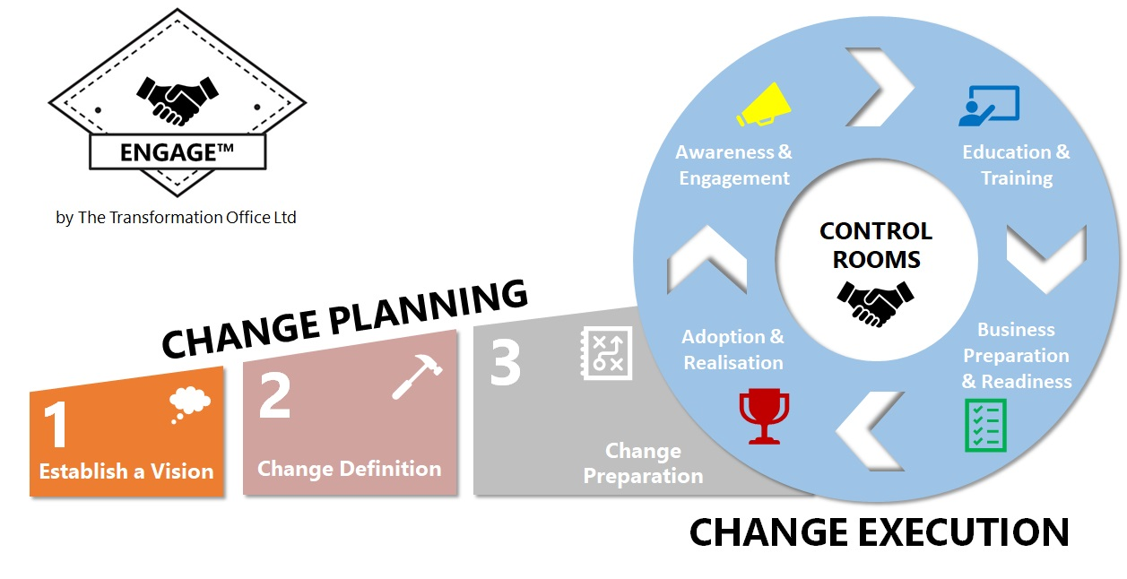
Template Name: ENGAGE™ Business Operating Model Template
Template Description: The ENGAGE™ Business Operating Model Template is used to record the current and target operating models for the business to help establish what the vision is for the business transformation.
ENGAGE™ Stage Alignment: This template is aligned to Stage 1 – Establish the Vision

Slide 2
BUSINESS MODEL TEMPLATE
SUPPLIERS
What supply chain relationships are required in the future?
RESOURCES / PEOPLE
What people / departments and skills will be required in the future? Are there any departments / people who are redundant through this change?
PROCESSES
What key functions / processes are required in the future to support the change? What functions / processes need to be dissolved?
PRODUCTS / SERVICES
What are the key products / services that the business will focus on in the future? Has there been a huge change in direction for the business e.g. entering into new markets?
CUSTOMERS / MARKETS
Who are the key customers / markets that the business needs to support?
ASSETS / INFRASTRUCTURE
What physical infrastructure is required to support the business? (locations, hardware, networks, equipment)
SYSTEMS / DATA
What applications / systems / data is required to underpin the revised target operating model?
FINANCIAL STRUCTURES
How will the business need to be structured financially in the future? E.g. Cost Centre or Profit Centre driven

